Slide 1
Intel Maker’s ESP32 course – by intel’s makers community class 4 – LCD hands On
Gil Tal.
Jun 2021

Slide 3
Class 4 agenda:
Briefly go back:
On graphics fundamentals
Our LCD and its connection to the ESP32
Driver structure
Our LCD driver (graphics.h)
TV out
LAB ☺
Basic operation of the LCD in both modes
Flappy Bird game

Slide 4
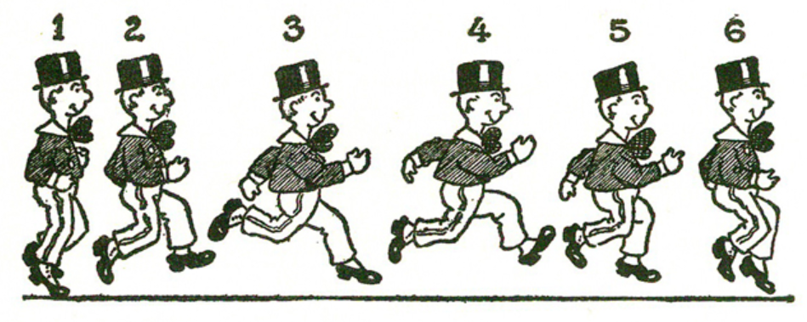
Animation basics…

Slide 5
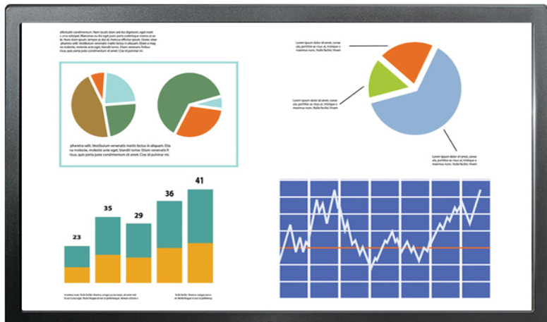
Basic graphics controller
Graphics
Memory
RGB
Graphics controller
(In our case – ST7789)
Interface to host
PCIe, SPI, I2C,UART, Parallel …
Memory structure:
Array of: RGB,RGB,RGB …. Or (ARGB,ARGB,ARGB…)
32, 24, 18, 16, or 3 bit per pixel (8888, 888, 666, 565, 111)

Slide 6
Few main technics
Option 1: Use one frame, just erase and draw what ever is needed, do it fast enough and it will look OK
Option 2: Use a scratch frame buffer, for each scene:
Erase the frame buffer
Draw the new scene
Send the new scene to the video controller
We need a frame rate greater than 30 to have smooth animation
Option 3: Combination of options 1 and 2
Use frame buffer
just erase and draw what ever is needed
Send the frame to the video controller

Slide 7
Mapping the LCD of our platform
In general mistakes in connectivity can damage a board!
Information for physical connectivity must be available for us
Interface used by the LCD is SPI:
MOSI – Master out slave in (drive data from ESP32 to the LCD)
Clock
CS – Chip Select
Reset
Out of spec signal - CMD\Data , distinguish between data or command transaction
Information for the specific I/Os used is in the schematic of the ESP32 TTGO module
Graphics.h is a general LCD\TV out driver that supports the platform’s ST7789 device
Small porting is needed

Slide 8
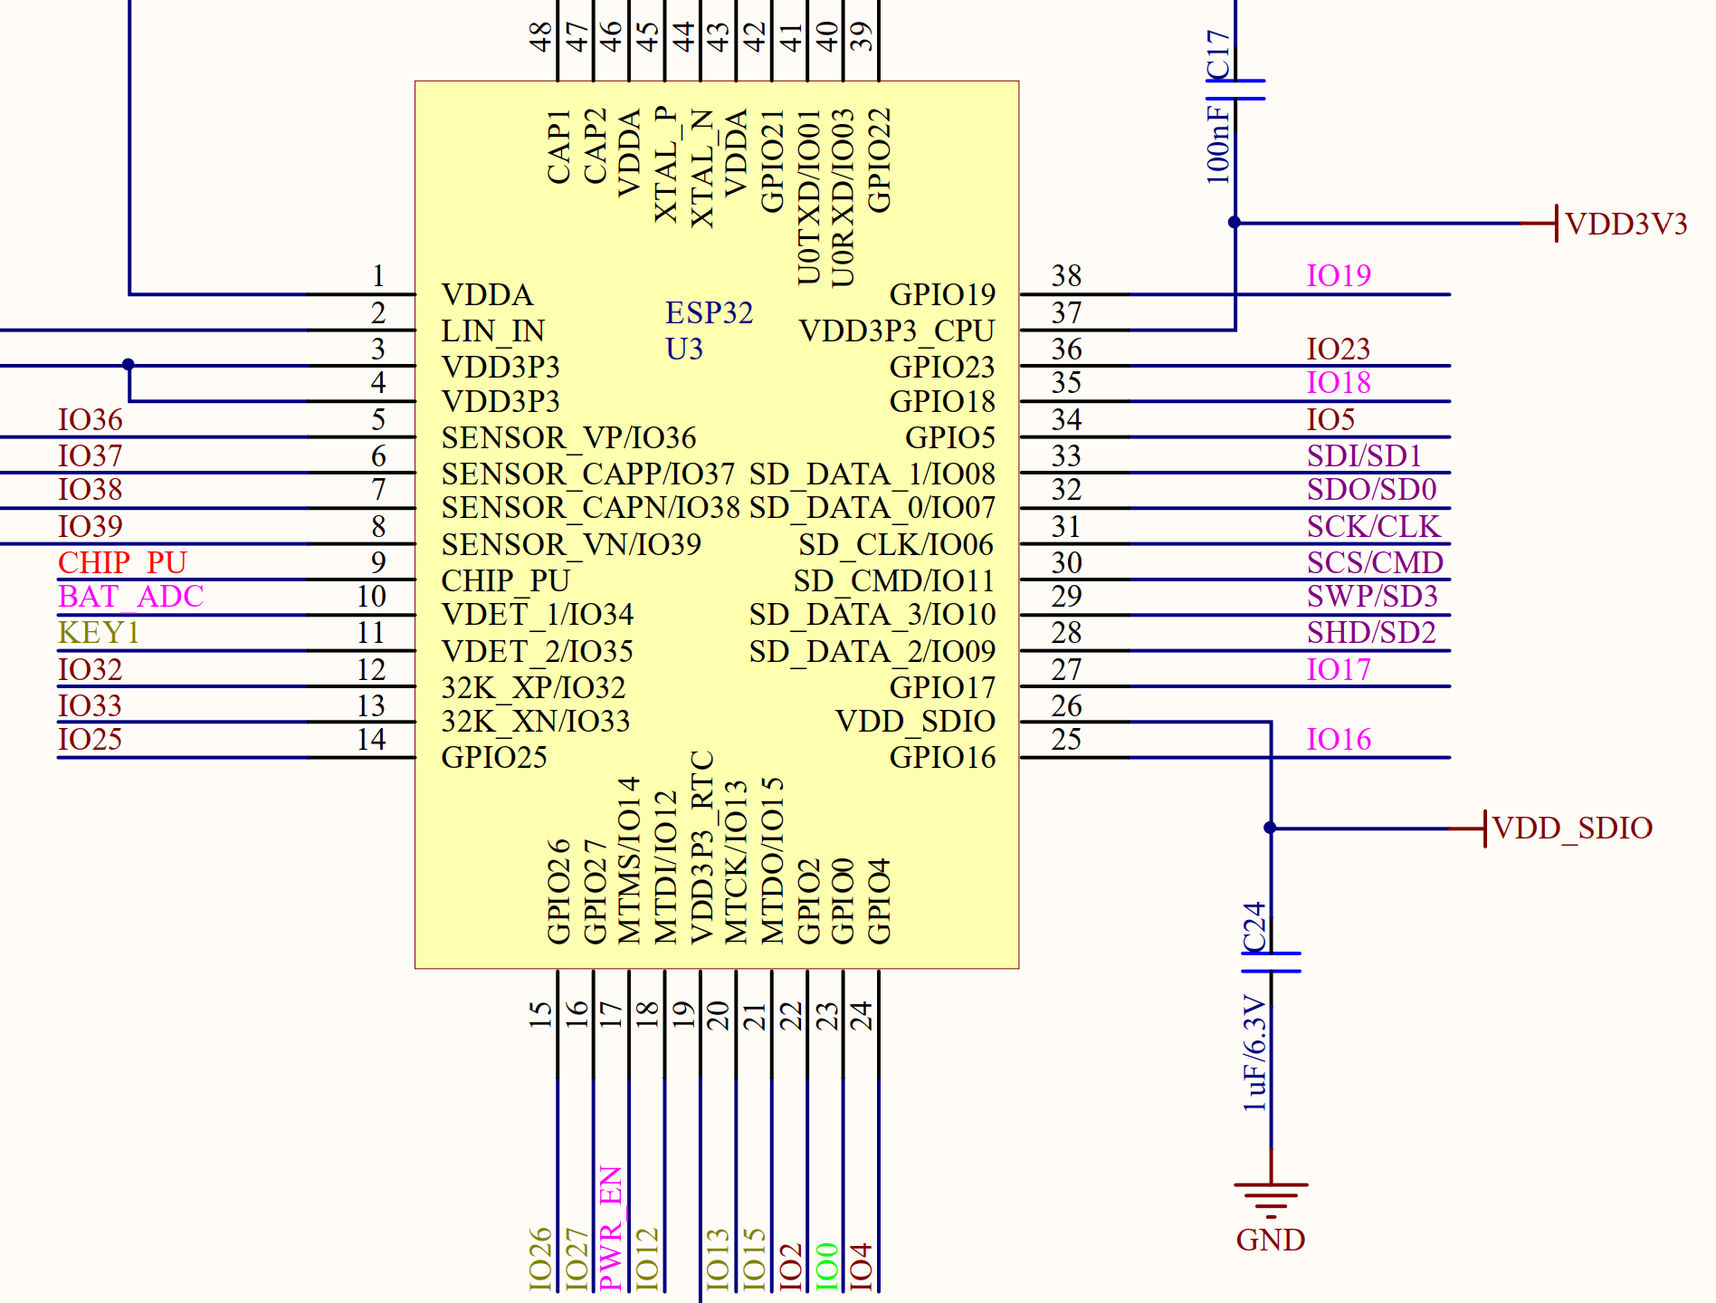
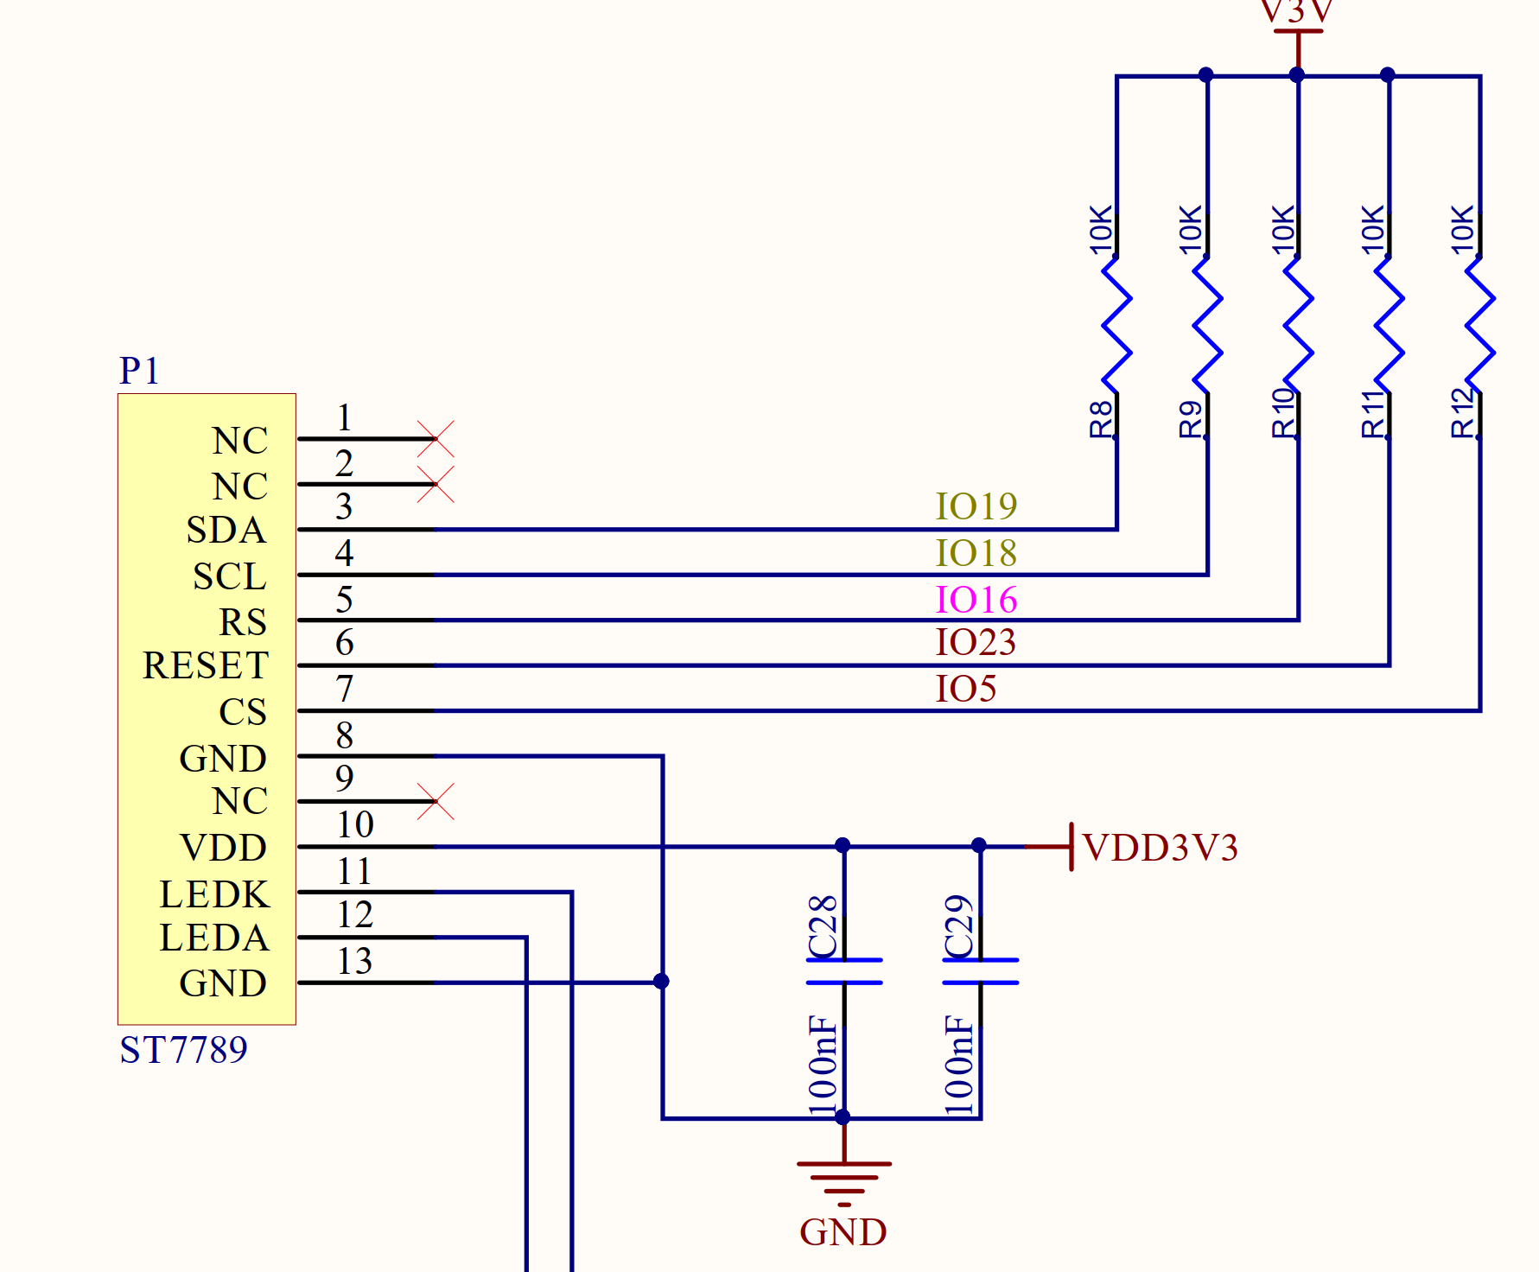
ESP32 TTGO module schematic
ESP32
SPI-MOSI
SPI Clock
Data\CMD
Chip Select

Slide 9
Device driver
Device Driver
Micro Controller
(ESP32)
Enable us to:
Utilize the device’s capabilities
Initialize the device
Device
(LCD for Example)
Device Driver
SW structure
HAL
Hardware Abstraction Layer
User API
Application Programming Interface

Slide 10
Our LCD – ST7789 based
SPI running at 40MHz one bit, with additional Command\Data control
Resolution: 240x135 or 135x240
RGB565 (64K colors): 72 FPS for full screen refresh
Two bytes per pixel
Two operation modes:
Local frame buffer in ESP32’s memory + LCD’s frame buffer
One frame buffer within the LCD

Slide 11
ESP32 and the LCD\TV out block diagram
RGB565 mode – Any write of the graphics drivers access the frame buffer memory directly
ESP32
ST7789
LCD
SPI
Optional Local
Frame buffer
Frame buffer
Memory
TV Out mode – Any write of the graphics drivers access the local frame buffer
At any time one frame buffer is active and the second is being refreshed directly to the TV
ESP32
TV
Local Frame buffer
Memory 0
DAC25
Local Frame buffer
Memory 1

Slide 12
TV Out – Uses DAC25 and I2S0
#include "graphics.h"
TVout tvOut;
void compositeCore(void *data)
{
while (true)
{
tvOut.sendFrame();
}
}
void setup()
{
tvOut.init();
xTaskCreatePinnedToCore(compositeCore, “tvOutTask", 1024, NULL, 1, NULL, 0);
}
void loop()
{
unsigned long time;
tvOut.fillScr(0xff, 0xff, 0xff);
tvOut.loadFonts(ORBITRON_LIGHT32);
tvOut.setColor(0, 0, 0);
tvOut.print("Driver Test...", 0, 100, true);
tvOut.setColor(0xff, 0x00, 0x00);
tvOut.drawCircle(50, 200, 20, true);
tvOut.setColor(0x00, 0xff, 0x00);
tvOut.drawCircle(100, 200, 20, true);
tvOut.setColor(0x00, 0x00, 0xff);
tvOut.drawCircle(150, 200, 20, true);
tvOut.swapFrameBuffers();
while (1);
}

Slide 13
Generating bitmaps and using them in our code
Pick your image, make it a BMP file with size no larger than 240x135
Use the BMPconverter.exe in the tools directory in the GIT
The tool generates a C file containing the array (bitmap)
Place the file in your project directory as is
Generate a declaration in your main file (where loop resides)
extern const unsigned char/unsigned int/unsigned short FlappyBird[];
LCD.drawCompressed24bitBitmap(x,y, FlappyBird);

